Slide 1
Task-1 Performance Grading

Slide 2
Performance Grading
High Performer (90% - 100%)
This category includes Style Advisors who consistently score in the top range. They have shown excellent customer service, store ambiance, and a high level of professionalism.
Average Performer (70% - 89%)
Style Advisors in this range meet expectations but may have room for improvement in certain areas such as product knowledge or customer interaction.
Low Performer (50% - 69%)
These Style Advisors have underperformed in one or more key areas, including customer service, first impressions, or store ambiance.
Bottom Performer (Below 50%)

Slide 3
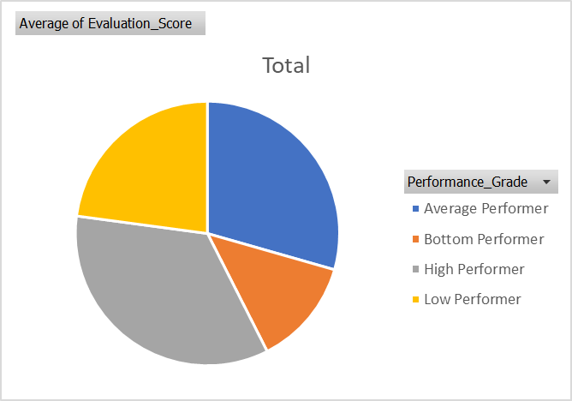

Slide 4
Average Evaluation Score by Zone
Overview:
This slide shows the average evaluation scores of Style Advisors across different zones. The performance of each zone is analyzed to identify regions where Style Advisors are performing well or need improvement.
Key Insights:
High-Performing Zones: Some zones consistently show higher average scores, indicating excellent customer service and strong performance by Style Advisors.
Low-Performing Zones: A few regions have lower average scores, signaling areas that might need targeted improvement in specific criteria such as customer service or store ambiance.
Interpretation:
By comparing average scores across zones, we can identify patterns and determine which regions may benefit from additional training or support.
Visual Representation:
A bar chart or column chart can show the average scores for each zone, making it easier to identify top performers and areas needing attention.

Slide 5
Average Evaluation Score by Zone
TASK 2

Slide 6
Percentage of High Performers by Region
Overview:
This slide displays the percentage of High Performers across different regions. It shows how many Style Advisors in each region are scoring in the High Performer category (90% - 100%).
Key Insights:
Top-Performing Regions: Some regions have a higher percentage of High Performers, indicating that these areas consistently produce top-quality service and performance.
Low-Performing Regions: In contrast, some regions may have a lower percentage of High Performers, pointing to areas that might need more focus or improvement.
Interpretation:
Identifying regions with the highest percentages of High Performers can highlight areas of success and serve as benchmarks for other regions.
Regions with fewer High Performers may benefit from additional training, support, or feedback to help Style Advisors improve their performance.
Visual Representation:
A pie chart can be used to show the percentage distribution of High Performers by region, making it visually clear which regions are excelling and which are underperforming.

Slide 7
Percentage of High Performers by Region

Slide 8
Average Evaluation Scores by Zone (Bar Chart)
TASK 3

Slide 9
Comparison of High vs. Low Performers
Overview:
This slide provides a comparison between High Performers and Low Performers across various regions or evaluation criteria. The stacked bar chart visually displays the proportion of High and Low Performers in each region or category.
Key Insights:
High Performers: The bars representing High Performers show regions or areas where Style Advisors are delivering exceptional service and performance.
Low Performers: The Low Performer portion of the bars highlights regions that are falling short of expectations and require further attention or intervention.
Interpretation:
A higher proportion of High Performers in a region or category suggests successful practices that can be replicated in other regions.
A higher proportion of Low Performers in certain regions indicates areas that need improvement, possibly through more training, support, or leadership intervention.
Actionable Insights:
Focus Areas: Regions with a high proportion of Low Performers should be prioritized for targeted improvement strategies, while High Performing regions can be looked at for best practices.
Benchmarking: High Performers can serve as a model for improvement in regions with more Low Performers.
Visual Representation:
A stacked bar chart will allow easy comparison of High vs. Low Performers for each region, displaying how each region is performing overall.

Slide 10
Performance Distribution Over Time (Line Graph)

Slide 11
Performance Breakdown by Criteria (Heatmap)
Row Labels | Average of Evaluation_Score
78
33 | 52
56 | 33
60 | 52
67 | 49
78 | 50.5
80 | 86
89 | 75.66666667
90 | 61.33333333
100 | 86
89
67 | 83
70 | 34
78 | 64
80 | 77.33333333
89 | 76.16666667
90 | 88
100 | 85
100
33 | 33
56 | 58
67 | 70
70 | 80
78 | 69
80 | 62
89 | 85.5
100 | 90.4
Grand Total | 71.78688525

Slide 12
Comparison of High vs. Low Performers (Stacked Bar Chart)

